Slide 1
False Confessions
James Davidson Ph.D.
Dallas | Plano | Lewisville
(972) 876-8180 Cell
drjwdavidson@gmail.com
www.jamesdavidson.net

Slide 2
“If a person is innocent of a crime, then he is not a suspect”
Attorney General Edwin Meese telling the American Bar Association that the Miranda decision advising those arrested of their rights was no longer necessary.
(Petras, R. (1993) The 776 Stupidest Things Ever Said

Slide 3
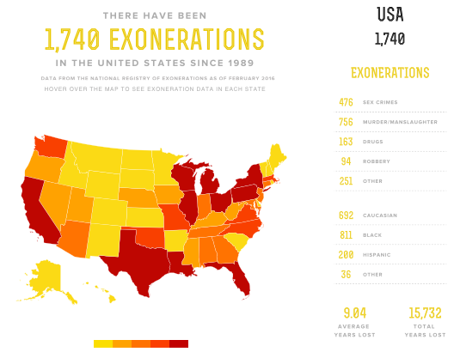
Unjust Justice – Exonerations in US

Slide 4
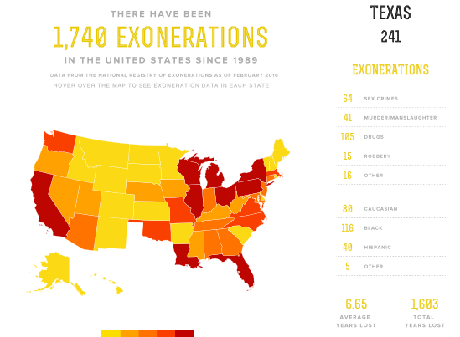
Unjust Justice – Exonerations in Texas

Slide 5
Exonerations: False Confessions
337 DNA Exonerations To Date
52 DNA Exonerations In Texas

Slide 6
Consequences of False Confessions
POLICE: Close Case, Ignore Contradictory Evidence, Refuse to Admit Error | PROSECUTORS: Set Higher Bail, More and Higher Charges, Make Centerpiece of State’s Case
DEFENSE ATTORNEYS: Presume Client’s Guilt; Pressure Client to Plead Guilty; A 78-85% risk of being wrongfully convicted if the case is not dismissed prior to trial (Leo & Ofshe, 1998; Drizin & Leo, 2004). | JURIES: More Likely to Convict, Even if Confession Was Coerced (Kassin & Sukel, 1997)
JUDGES: Sentence Higher for Failure to Show Remorse | POST-CONVICTION: Law Almost Never Permits Appeals Based on Innocence

Slide 7
Who Says “I Did It” - When They Didn’t?
The 4 I’s: People at greatest risk
Immature (Juveniles)
Impaired (Developmentally Delayed)
Imbalanced (Mentally Ill)
Impressionable (Sheeple)

Slide 8
Six Types of False Confessions
1. Voluntary false confession
    1. Reasons: Notoriety, Protect someone, Need for punishement
2. Coerced compliant false confession
    Reasons: Solicited via interrogation tactics and desire to stop the questioning, thought of going home or perception of less punishment
3. Retracted confession
    1. Reasons: Once out of interrogation setting the fact that the confession was false emerges

Slide 9
Six Types of False Confessions
4. Coerced internalized false confession
    1. Reasons: Attained via an impressionable subject’s internalization of crime due to Reid techniques (lying about evidence witnesses etc.), and often accompanied by the subject’s memory lapse due to drug or alcohol use.
5. Coerced reactive false fonfession
    1. Reasons: Third party pressure to confess (i.e. gang member or abusive spouse)
6. Coerced substituted false confession
    1. Reasons: Subject has committed a number of similar crimes (i.e. GTA) and can’t’ remember all of his crimes – so agrees to similar crimes added by the police.

Slide 10
Pathways to False Confessions
Misclassification Error: Police erroneously conclude the subject is guilty Interview becomes and interrogation
  Police believe they can detect lying better than most – but research says otherwise. Police cannot reliably detect false and true confessions.
Coercion Error: Police interrogate with coercive tactics
  Accusations of guilt, lies about evidence, sleep deprivation, lengthy interrogations, allusions to “going home tonight”, empathy.
Contamination Error: Police contaminate the subject’s story or false confession
  Shape the narrative with leading questions, playing on a subject’s memory, showing crime scene photos or giving details, fabrication

Slide 11
The Reid Technique
Pathway to False Confessions
What is the Reid Technique: 9 Step Method for interview and interrogation taught to thousands of police departments
The prevalence of the Reid Technique (and variations)
  Minimization techniques: Soft sell tactics that provide a sense of false security (e.g., justifying the crime)
  Maximization techniques: Scare tactics that attempt to intimidate suspects (e.g., making up evidence)
The difference between interview and interrogation
  Information versus accusation

Slide 12
The Reid Technique
Pathway to False Confessions
Police interrogation tactics
  Police can lie to a suspect (we have your prints, your hair, a witness identified you, etc)
  Police can accuse a suspect of a crime
  Police can use tactics that promote confusion that lead to false confessions, such as attacking the suspect’s alibi, or interrupting the suspect’s denials
  Police can manipulate by suggesting face saving alternatives or justification while noting “do what’s right” or “we all just want to go home tonight.”

Slide 13
When Do False Confessions Occur?
Without representation (Miranda waiver AND waiver failure, i.e. not voluntary, knowing and intelligent)
After lengthy questioning (exhaustion)
After abusive questioning (coercion)
After an interrogator prepares a false statement
After an interrogator becomes convinced that the subject did it (confirmatory bias)
Grisso (1980) Juvenile’s capacity to waive Miranda rights

Slide 14
When To Call An Expert
Major felony
Vulnerable defendant
Evidence of flawed Miranda waiver or interrogation
Sooner than later
Adequate funding
Adequate records (Audio/video OR amazing lack of records)
Court Order

Slide 15
The Expert’s Task
Identify the referral question
Review multiple sources of information
Interview the defendant
Convey a verbal report
Prepare a written Psychological Evaluation
Testify

Slide 16
The Expert’s Task:
Three Main Referral Questions
Miranda Waiver: Did the State fail to prove, by a preponderance of the evidence, that the defendant knowingly, intelligently, and voluntarily waiver their Miranda rights?
Voluntary Confession: Did the State fail to prove, by a preponderance of the evidence, that the defendant’s confession was freely and voluntarily made under the totality of the circumstances?
Knowing and Intelligent Confession: Should the Court suppress the defendant’s statements to the police because the statements are highly unreliable and virtually uncorroborated due to coercion or other factors?

Slide 17
Pathways to Asking the Referral Question (AKA The Smell Test)
Was The Subject a Vulnerable Person?
  Immature, Impaired, Imbalanced, Impressionable
Does the subject voluntarily show, without prompting, culpability?
Were Interrogation Techniques Likely to Prompt a False Confession?
  Deception
  Coercion
  Leading questions
  Suggesting withheld facts to shape the subject’s statements
  Lengthy interrogations(more than 2 hours)
  Not recorded or poorly recorded/documented
  Police preparing the post interrogation admission/confession statement for the subject
  Etc.

Slide 18
The Expert’s Task:
Review Multiple Sources of Info
What was the setting?
  The room, people present, time temperature and length of interrogation, provision of food, etc.
What takes place on the record (audio, video or written)?
  Can everyone be clearly understood?
  How was the interrogation conducted?
  Were interrogation techniques used that could prompt a false confession?
  Was there evidence of the defendant’s culpability?
What is contained in police reports, 911 calls, health records etc.?
Background information on the defendant.

Slide 19
The Expert’s Task:
Interview the Defendant
Is The defendant a Vulnerable Person?
Does the defendant voluntarily show, without prompting, culpability?
What are the defendant’s strengths and weaknesses?
What was the defendant’s mental and physical state at the time of the Miranda warning and waiver, during the interrogation and upon confessing?
What are the results of a Psychological Evaluation, i.e. clinical interview and testing?
What does the defendant say about their confession?

Slide 20
The Expert’s Task:
Convey a Verbal Report
The verbal report briefly summarizes the findings, and provides enough information for the ADA to determine whether or not they should proceed with challenging the Miranda waiver and/or confession.

Slide 21
The Expert’s Task:
Prepare a Written Psychological Evaluation
The psychological report would present, in defensible detail, the following:
  Referral question
  Notification, limitations, procedures and data sources
  History
  Prior Psychological Evaluations
  Forensic Interview
  Forensic Assessment of Understanding (Miranda or Confession)
  Forensic Assessment of Malingering
  Discussion and Conclusions

Slide 22
The Expert’s Task: Testify
Some psychologists, by virtue of their knowledge, training and experience, are able to assist the Court in each of the following areas:
Assess “the physical and psychological environment in which the [waiver] was obtained” (Crane v. Kentucky, 1986, p. 684).
Evaluate the defendant’s mental status, including psychopathology, intelligence, memory, and comprehension.
Reconstruct the defendant’s mental state at the time of the waiver and/or confession (similar to MSO/NGRI report)
Assist the Court in understanding the intersection of these factors.

Slide 23
Resources
The Innocence Project
The Innocence Project of Texas http://www.ipoftexas.org/
National Registry of Exonerations http://www.law.umich.edu/special/exoneration/Pages/about.aspx
Conviction Integrity Unit – Dallas County District Attorney https://www.dallascounty.org/department/da/conviction_integrity.php
DeClue, G. (2005) Interrogations and disputed confessions. Sarasota FL: Processional Resource Press.
Drizin, S. & Leo, R. (2005) THE PROBLEM OF FALSE CONFESSIONS IN THE POST-DNA WORLD.

Slide 24
Resources
Inbau, F. E. et al. (2011) Criminal interrogations and confessions. Burlington, MA: Jones & Bartlett Learning
Kassin, S. et al (2010) Police-Induced Confessions: Risk Factors and Recommendations. Law & Human Behavior 34: 3-38.
Lassiter, G. & Meissner, Chuck . (2010) Police interrogations and false confessions: Current research, practice and policy recommendations. Washington DC: American Psychological Association.
Redlich, A. & Meissner, C. (2016) Techniques and Controversies in the Interrogation of Suspects: The Artful Practice versus the Scientific Study. In press.

